Slide 1

Lecture 10
Relational Database Design
BCNF
Addendum
Dr. Jefferson Fong
Reference: 7.3 and 7.5

Slide 2

Project
Static (HTML and CSS) web pages are due on Sun Nov 30.
  You can use other software tools for the front end, but no extra credit will be given on how nice you web pages look.
  Our focus is on the database. See the Course Project links for details.
  The front end needs to be good enough to demonstrate the database requirements.

Slide 3
Make-up Midterm
Students who are approved to take the make-up midterm exam have been notified. Please join the WeCom chat group.

Slide 4
Last Time
Functional Dependency (FD) is a generalization of a key.
A → {B, C} means columns B, C are determined by column A.
  {A, B, C} forms a “nice” table with A as the key.
There is an algorithm to decompose a schema into “nice” tables.

Slide 5
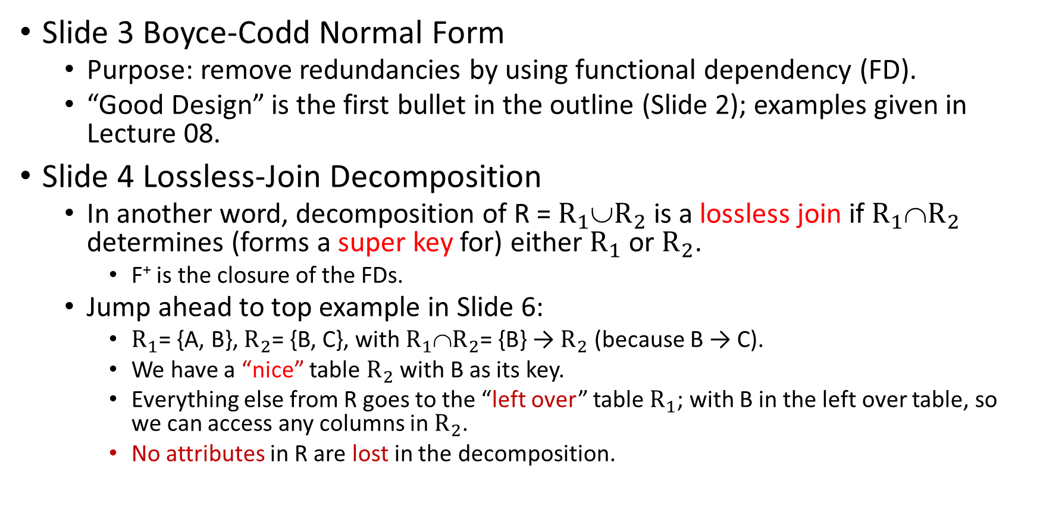
Boyce-Codd Normal Form (BCNF)
Slide 3 Boyce-Codd Normal Form
  Purpose: remove redundancies by using functional dependency (FD).
  “Good Design” is the first bullet in the outline (Slide 2); examples given in Lecture 08.
Slide 4 Lossless-Join Decomposition
  In another word, decomposition of R = $R_{1}$∪$R_{2}$ is a lossless join if $R_{1}$∩$R_{2}$ determines (forms a super key for) either $R_{1}$ or $R_{2}$.
    F⁺ is the closure of the FDs.
  Jump ahead to top example in Slide 6:
    $R_{1}$= {A, B}, $R_{2}$= {B, C}, with $R_{1}$∩$R_{2}$= {B} → $R_{2}$ (because B → C).
    We have a “nice” table $R_{2}$ with B as its key.
    Everything else from R goes to the “left over” table $R_{1}$; with B in the left over table, so we can access any columns in $R_{2}$.
    No attributes in R are lost in the decomposition.

Slide 6
Slide 5 (Functional) Dependency Preservation
  Means all FDs in F⁺ are preserved.
  In English, “lossless” and “preserved” are synonyms.
  In DBMS,
    Lossless refers to attributes.
    Preserved refers to FDs.

Slide 7
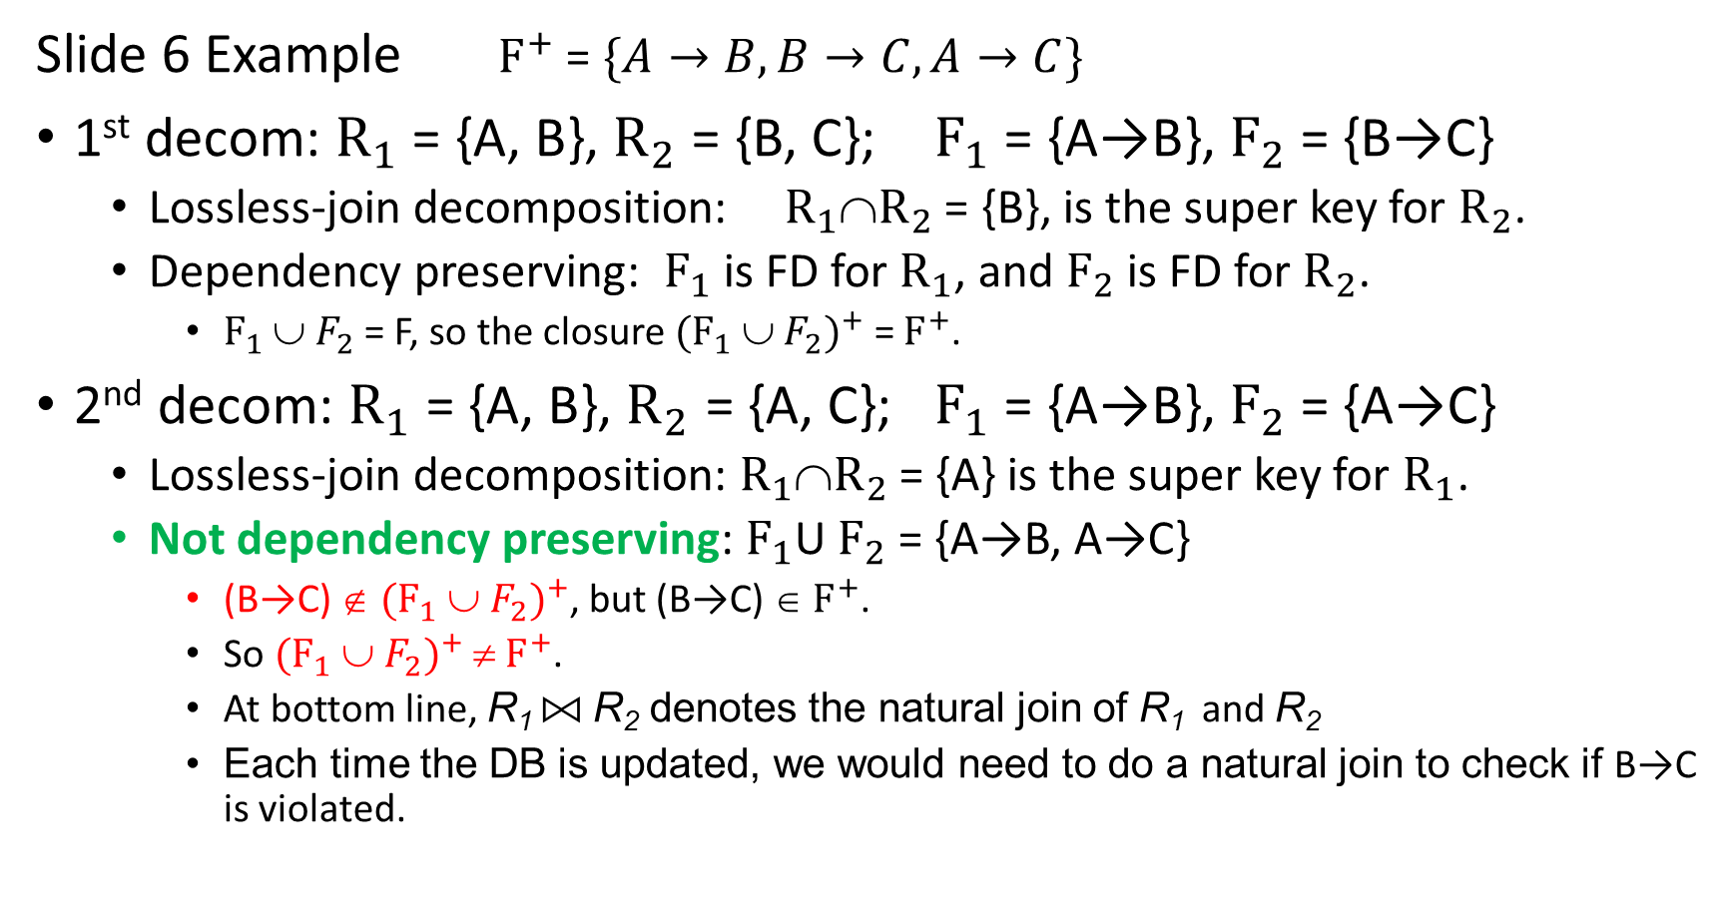
Slide 6 Example $F^{+}$ = $\{A→B, B→C,A→C\}$
1st decom: $R_{1}$ = {A, B}, $R_{2}$ = {B, C}; $F_{1}$ = {A→B}, $F_{2}$ = {B→C}
  Lossless-join decomposition: $R_{1}$∩$R_{2}$ = {B}, is the super key for $R_{2}$.
  Dependency preserving: $F_{1}$ is FD for $R_{1}$, and $F_{2}$ is FD for $R_{2}$.
    $F_{1}$ ∪ $F_{2}$ = F, so the closure ${(F_{1} \text{∪ }F_{2})}^{+}$ = $F^{+}$.
2nd decom: $R_{1}$ = {A, B}, $R_{2}$ = {A, C}; $F_{1}$ = {A→B}, $F_{2}$ = {A→C}
  Lossless-join decomposition: $R_{1}$∩$R_{2}$ = {A} is the super key for $R_{1}$.
  Not dependency preserving: $F_{1}$U $F_{2}$ = {A→B, A→C}
    (B→C) ∉ ${(F_{1} \text{∪ }F_{2})}^{+}$, but (B→C) ∈ $F^{+}$.
    So ${(F_{1} \text{∪ }F_{2})}^{+}$ ≠ $F^{+}$.
    At bottom line, R₁ ⨝ R₂ denotes the natural join of R₁ and R₂
    Each time the DB is updated, we would need to do a natural join to check if B→C is violated.

Slide 8
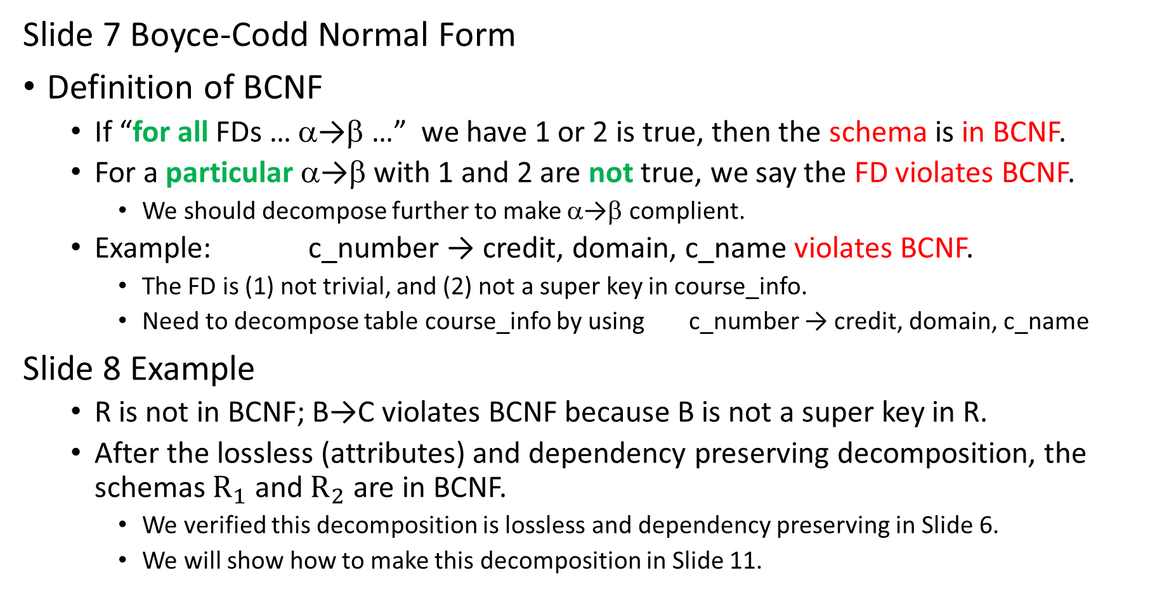
Slide 7 Boyce-Codd Normal Form
Definition of BCNF
  If “for all FDs … α→β …” we have 1 or 2 is true, then the schema is in BCNF.
  For a particular α→β with 1 and 2 are not true, we say the FD violates BCNF.
    We should decompose further to make α→β complient.
  Example: c_number → credit, domain, c_name violates BCNF.
    The FD is (1) not trivial, and (2) not a super key in course_info.
    Need to decompose table course_info by using c_number → credit, domain, c_name
Slide 8 Example
  R is not in BCNF; B→C violates BCNF because B is not a super key in R.
  After the lossless (attributes) and dependency preserving decomposition, the schemas $R_{1}$ and $R_{2}$ are in BCNF.
    We verified this decomposition is lossless and dependency preserving in Slide 6.
    We will show how to make this decomposition in Slide 11.

Slide 9

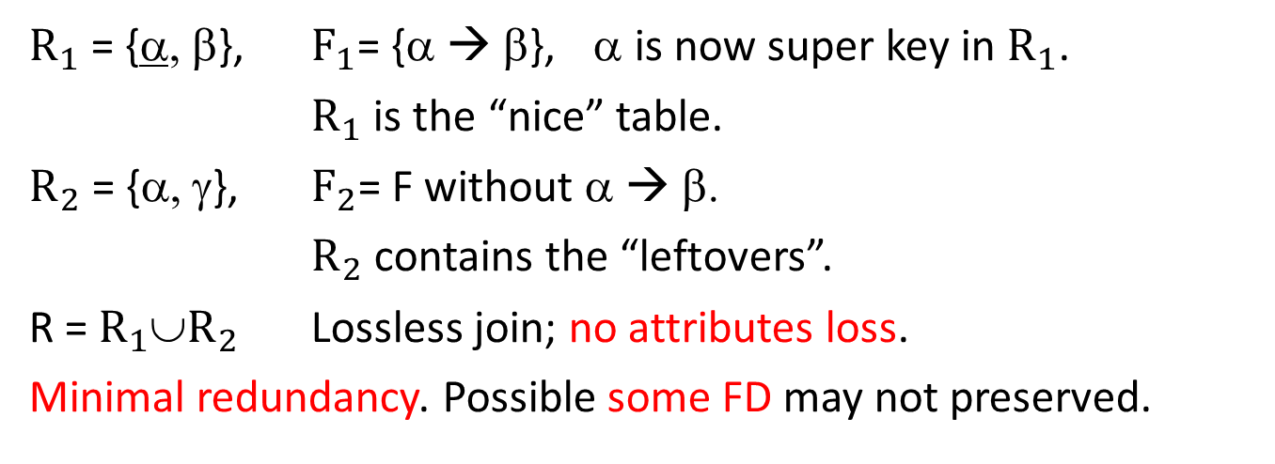
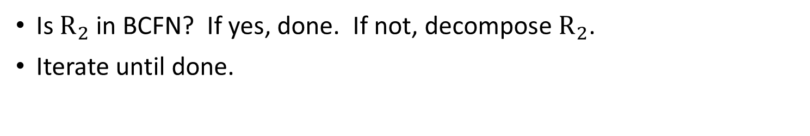

BCNF Basic Idea
R
R = {α, β, γ}, F = {α → β, …}
If α is not a super key in R, we decompose R and F.
α | β | γ
$R_{1}$ = {α, β}, $F_{1}$= {α → β}, α is now super key in $R_{1}$.
$R_{1}$ is the “nice” table.
$R_{2}$ = {α, γ}, $F_{2}$= F without α → β.
$R_{2}$ contains the “leftovers”.
R = $R_{1}$∪$R_{2}$ Lossless join; no attributes loss.
Minimal redundancy. Possible some FD may not preserved.
$R_{1}$
$R_{2}$
α | β
α | γ
U
Is $R_{2}$ in BCFN? If yes, done. If not, decompose $R_{2}$.
Iterate until done.

Slide 10
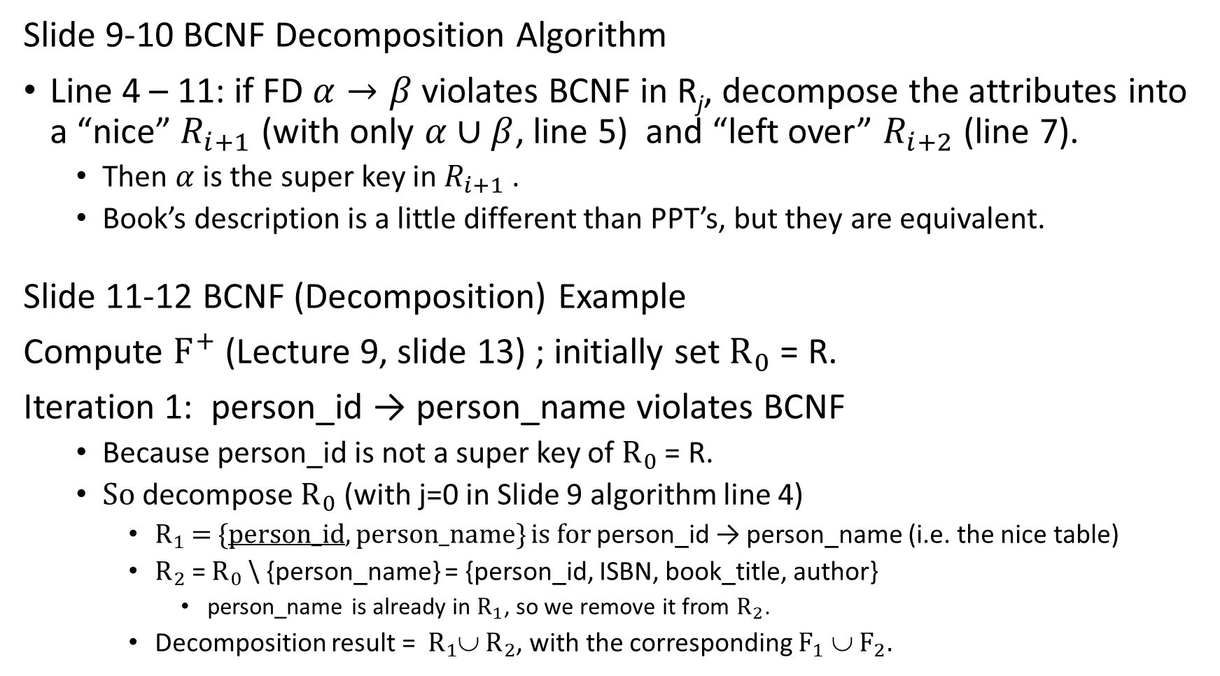
Slide 9-10 BCNF Decomposition Algorithm
Line 4 – 11: if FD $α→β$ violates BCNF in R_{j}, decompose the attributes into a “nice” $R_{i+1}$ (with only $α∪β$, line 5) and “left over” $R_{i+2}$ (line 7).
  Then $α$ is the super key in $R_{i+1}$ .
  Book’s description is a little different than PPT’s, but they are equivalent.
Slide 11-12 BCNF (Decomposition) Example
Compute $F^{+}$ (Lecture 9, slide 13) ; initially set $R_{0}$ = R.
Iteration 1: person_id → person_name violates BCNF
  Because person_id is not a super key of $R_{0}$ = R.
  So decompose $R_{0}$ (with j=0 in Slide 9 algorithm line 4)
    $R_{1}$ = {person_id, person_name} is for person_id → person_name (i.e. the nice table)
    $R_{2}$ = $R_{0}$ \ {person_name} = {person_id, ISBN, book_title, author}
      person_name is already in $R_{1}$, so we remove it from $R_{2}$.
    Decomposition result = $R_{1}$∪ $R_{2}$, with the corresponding $F_{1}$ ∪ $F_{2}.$

Slide 11
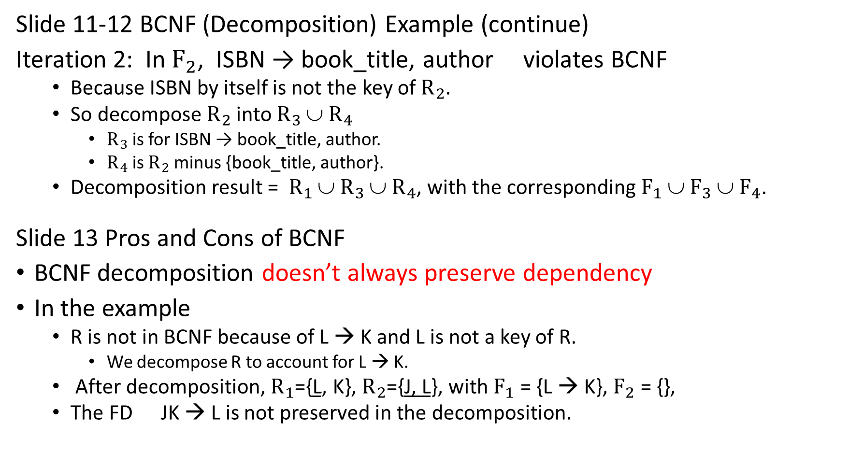
Slide 11-12 BCNF (Decomposition) Example (continue)
Iteration 2: In $F_{2}$, ISBN → book_title, author violates BCNF
  Because ISBN by itself is not the key of $R_{2}$.
  So decompose $R_{2}$ into $R_{3}$ ∪ $R_{4}$
    $R_{3}$ is for ISBN → book_title, author.
    $R_{4}$ is $R_{2}$ minus {book_title, author}.
  Decomposition result = $R_{1}$ ∪ $R_{3}$ ∪ $R_{4}$, with the corresponding $F_{1}$ ∪ $F_{3}$ ∪ $F_{4}$.
Slide 13 Pros and Cons of BCNF
BCNF decomposition doesn’t always preserve dependency
In the example
  R is not in BCNF because of L → K and L is not a key of R.
    We decompose R to account for L → K.
  After decomposition, $R_{1}$={L, K}, $R_{2}$={J, L}, with $F_{1}$ = {L → K}, $F_{2}$ = {},
  The FD JK → L is not preserved in the decomposition.

Slide 12
Questions about BCNF:
Does it matter which FD to start?
Yes, consider R={A, B, C}, F={A→B, B→C, C→A}
  Possible candidate keys (from F) are {A}, {B}, {C}.
  So F⁺ = {A→BC, B→AC, C→AB}
  If we start with A→BC, R=R₁={A, B, C}, but B→AC and C→AB are not preserved.
  If we start with B→AC, R=R₁={B, A, C}, but A→BC and C→AB are not preserved.
  The final R is the same (no attributes are lost), but the final FDs can be different (different FDs are not preserved).
  The union of the final R_{i} is unique, but the union of the final FD_{i} is not unique.
We start with a FD that violates BCNF because that R_{i} must be decomposed.

Slide 13
Intro to Lab 10

